Slide 1
Syntax-based Testing Program-based Mutation Testing CS 4501 / 6501 Software Testing

Slide 2
Structures for Criteria-Based Testing
Four structures for modeling software
Input space
Graph
Logic
Syntax
Source
Source
Source
Applied to
Applied to
Applied to
Design
Specs
Models
Specs
FSMs
Integration
Use cases
DNF
Inputs
---R
R--R
RI-R
RIPR
Notes:
FSM = Finite State Machine
DNF = Disjunctive Normal Form

Slide 3
Applying Syntax-Based Testing to Programs
Test requirements are derived from the syntax of software artifacts
Syntax-based criteria originated with programs and have been used mostly with program source code
BNF criteria are most commonly used to test compilers
Use BNF criteria to generate programs to test all language features that compilers must process
Mutation testing criteria are most commonly used for unit testing and integration testing of classes

Slide 4
Overview
Basic: concepts of mutation, mutation operators, mutants, killing mutants
Tools for mutation testing: MuJava and PIT
Subsumption of other coverage criteria using program-based mutation
Mutation operators for integration testing
Mutation operators for web applications

Slide 5
Instantiating Grammar-Based Testing
Grammar-Based Testing
Program-based
Integration
Model-Based
Input-Based
Grammar
String mutation
String mutation
String mutation
Grammar
String mutation
Program mutation
Valid strings
Mutants are not tests
Must kill mutants
Test how classes interact
Valid strings
Mutants are not tests
Must kill mutants
Includes OO
FSMs
Model checking
Valid strings
Traces are tests
Input validation
testing
XML and others
Invalid strings
No ground strings
Mutants are tests
Input validation testing
XML and others
Valid strings
Compiler testing
Valid and invalid strings

Slide 6
Mutation Testing
Inject changes into programs
Strongest testing criterion
Exceptionally effective criterion for designing and evaluating tests
Applied to C, C++, Java, JavaScript, Android, spreadsheet, policy
Premise:
If the software has a fault, there usually are some mutants that can only be killed by a test that also detects that fault.
Kill:
The test makes the output of the original program different from the output of the mutant

Slide 7

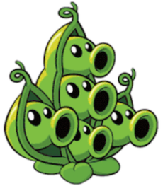







Mutation Testing
Effective tests
Find last index of zero
int lastZero (int[] x) {
for (int i = x.length-1; i >= 0; i--) {
if (x[i] == 0)
return i;
}
return -1;
}
i > 0
Original Program
Input: x = {1, 1, 2};
Output original: -1
Output mutant: -1
Input: x = {0, 1, 2};
Output original: 0
Output mutant: -1
Ineffective
Killed!
Ineffective tests
Test x = {0, 1, 2};
Very effective at exploring the boundary case
[Thanks to Lin Deng]

Slide 8

Mutation Testing
Mutation operators
Rules that specify how to modify the code (mutate)
Well designed operators result in power tests
Mutation operators do one of two tasks
Mimic typical programmer mistakes
Encourage common test heuristics
We use mutation testing to
Help testers design high quality tests
Evaluate the quality of existing tests
Mutation scores $=\frac{\# mutants killed}{\# non−equivalent mutants}$
Subject programs
Run tests on subject program
Killing
mutant
Apply
mutation operators
Generate tests
no
yes
Record
killed
mutants
Distinguishable result?
mutants
Run tests on mutants
Must be
valid strings
(compilable)
Mutants are not tests, but used to find tests
Notes:
Goals of mutation operators:
Mimic typical programmer mistakes, thus trying to ensure that the tests can detect those mistakes
Force the testers to create tests that have been found to effectively test software
Uses of mutation testing
Help generate tests
Evaluate how good exiting tests (or criteria) are

Slide 9
Killing Mutants
Given a mutant m ∈ M for a ground string program P and a test t, t is said to kill m if and only if the output of t on P is different from the output of t on m.
The quality of tests depends on mutation operators
If the operators are designed well, the resulting testes will be very powerful
Different operators must be defined for different programming languages and different goals
Testers can keep adding tests until all mutants have been killed
A mutant is killed if there is a test case for which the test results are different from the original program
Killing mutants $≈$ exposing faults

Slide 10
Categories of Mutants
Dead mutant
A test case has killed it
The fault that a dead mutant represents will be detected by the same test that killed it
Uncompilable mutant
Syntactically illegal
Should not be generated or should be immediately discarded
Trivial mutant
Almost every test can kill it
(Functionally) equivalent mutant
No test can kill it (same behavior or output as original, for all inputs)
Infeasible test requirements

Slide 11
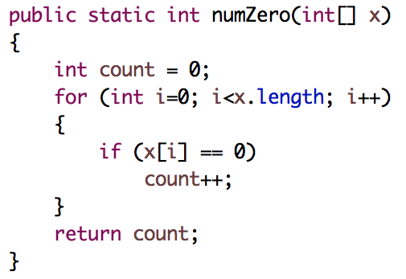
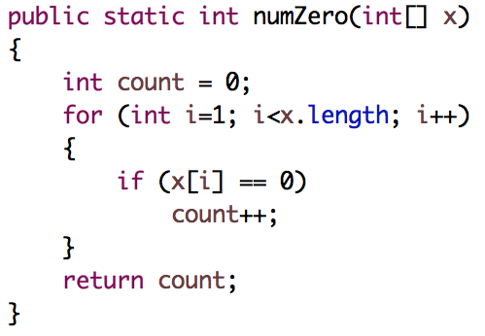
Example: Program Mutation
Original method
A fault is introduced by mutating the code
Mutant

Slide 12
Example: Program Mutation
i=1 is a mutation of i=0
The code obtained by changing i=0 to i=1 is called a mutant of numZero
A test kills the mutant if the mutant yields different outputs from the original code
Consider t1 = {1, 0, 0}
Original returns 2, mutant returns 2, the mutant is not killed
Consider t2 = {0, 1, 0}
Original returns 2, mutant returns 1, the mutant is killed

Slide 13
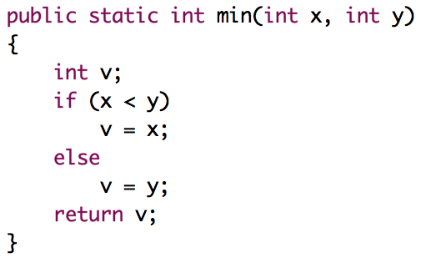
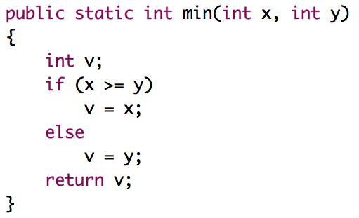

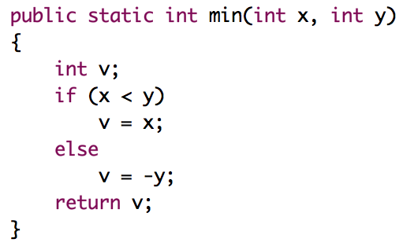
Example 2
Original method
mutant1
Each mutated statement represents a separate program
mutant2
mutant3

Slide 14
Example 2
Consider the following tests
t1 = min(0, 0)
t2 = min(0, 1)
t3 = min(1, 0)
Which mutants will be killed by which tests?
mutant1
mutant2
mutant3

Slide 15
Example 2
 | x | y | min | m1 | m2 | m3
t1 | 0 | 0 | 0 | 0 | 0 | 0
t2 | 0 | 1 | 0 | 1 | 0 | 0
t3 | 1 | 0 | 0 | 1 | 0 | 0
mutant1
t1 kills none of the mutants
t2 kills m1
t3 kills m1
mutant2
mutant3
Equivalent mutant

Slide 16
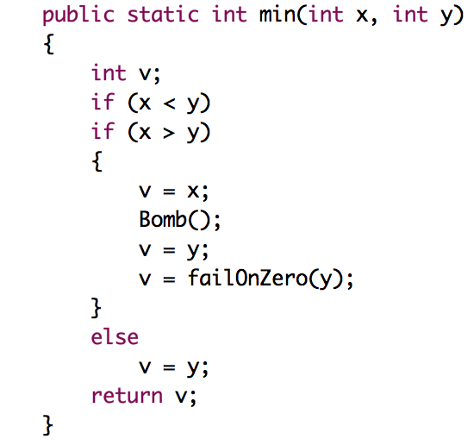
Example 3
With embedded mutants
Replace operator
1
Immediate runtime failure .. If reached
Original method
2
Replace one variable with another
3
Mutant 4: force the tester to create tests that cause every variable and expression to have the value of zero
4
Immediate runtime failure if y == 0, else does nothing

Slide 17
Mutation Coverage
Mutation Coverage (MC): For each m ∈ M, TR contains exactly one requirement, to kill m.
The RIPR model
Reachability: the test causes the faulty (mutated) statement to be reached
Infection: the test causes the faulty statement to result in an incorrect state
Propagation: the incorrect state propagates to incorrect output
Revealability: the tester must observe part of the incorrect output
The RIPR model leads to two variants of mutation coverage

Slide 18
1. Strong Mutation Coverage
Strong Mutation Coverage (SMC): For each m ∈ M, TR contains exactly one requirement, to strongly kill m.
Require reachability, infection, and propagation
Output of running a test set on the original program is different from the output of running the same test set on a mutant

Slide 19
2. Weak Mutation Coverage
Weak Mutation Coverage (WMC): For each m ∈ M, TR contains exactly one requirement, to weakly kill m.
Require reachability and infection, not propagation
Check internal state immediately after execution of the mutated statement
If the state is incorrect, the mutant is killed
Require less analysis
A few mutants can be killed under weak mutation but not under strong mutation (no propagation)
Incorrect state does not always propagate to the output
Studies have found that test sets that weakly kill all mutants also strongly kill most mutants

Slide 20
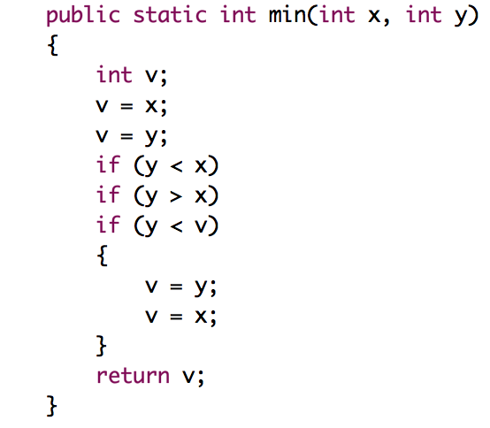
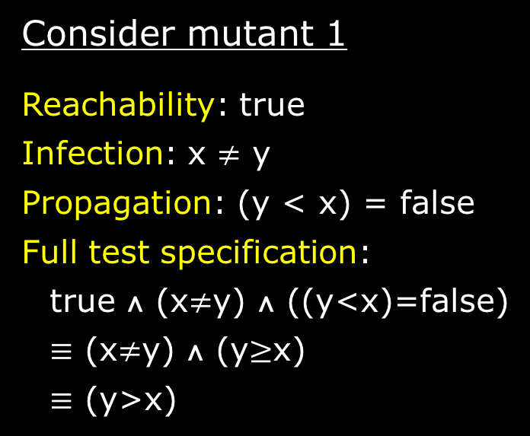
Example (Mutant 1)
Consider mutant 1
Reachability: true
Infection: x $≠$ y
Propagation: (y < x) = false
Full test specification:
true ∧ (x$≠$y) ∧ ((y<x)=false)
$≡$ (x$≠$y) ∧ (y$≥$x)
$≡$ (y>x)
1
2
3
4
Test case value:
(x = 3, y = 5) strongly kill, weekly kill mutant 1
(x = 5, y = 3) weakly kill, but not strongly kill

Slide 21
Example (Mutant 3)
Consider mutant 3
Reachability: true
Infection: (y < x) != (y < v)
1
2
However, the previous statement was v = x
Substitute the infection condition, we get
(y < x) != (y < x)
“Logical contradiction”
3
4
No input can kill this mutant … “Equivalent mutant”

Slide 22
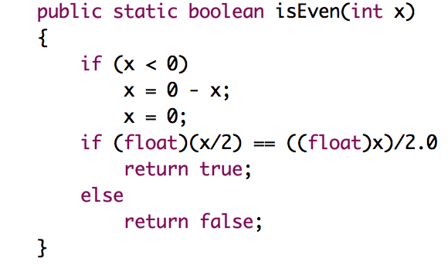
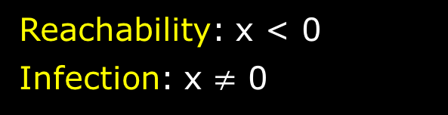
Strong vs. Weak Mutation
Reachability: x < 0
Infection: x $≠$ 0
1
Given a test (x = -6)
Kills the mutant under weak mutation, but not under strong mutation
Propagation:
( (float)((0-x)/2)==((float)(0-x))/2.0 ) != ( (float)(0/2)==((float)0)/2.0 )
The only value of x that will satisfy this condition is x must not be even
To strongly kill, propagation requires x must be an odd, negative integer

Slide 23
Testing Programs with Mutation
Automated steps
Input test program
( P )
Create
mutants
Run equivalence
detector
Generate
test cases
( T )
Run T
on P
no
Run T
on mutants
Define
threshold
Threshold
reached?
Eliminate
ineffective TCs
P ( T )
correct ?
yes
Fix P
no
yes
[AO, figure 9.2, p. 246]

Slide 24
Designing Mutation Operators
Mutation Operators do one of two tasks:
Mimic typical programmer mistakes
Encourage common test heuristics
Researchers design many operators, then experimentally
Select the most useful operators
Remove the redundant operators
Effective Mutation Operators
If tests that are created specifically to kill mutants created by a collection of mutation operators O = {o1, o2, …} also kill mutants created by all remaining mutation operators with very high probability, then O defines an effective set of mutation operators

Slide 25
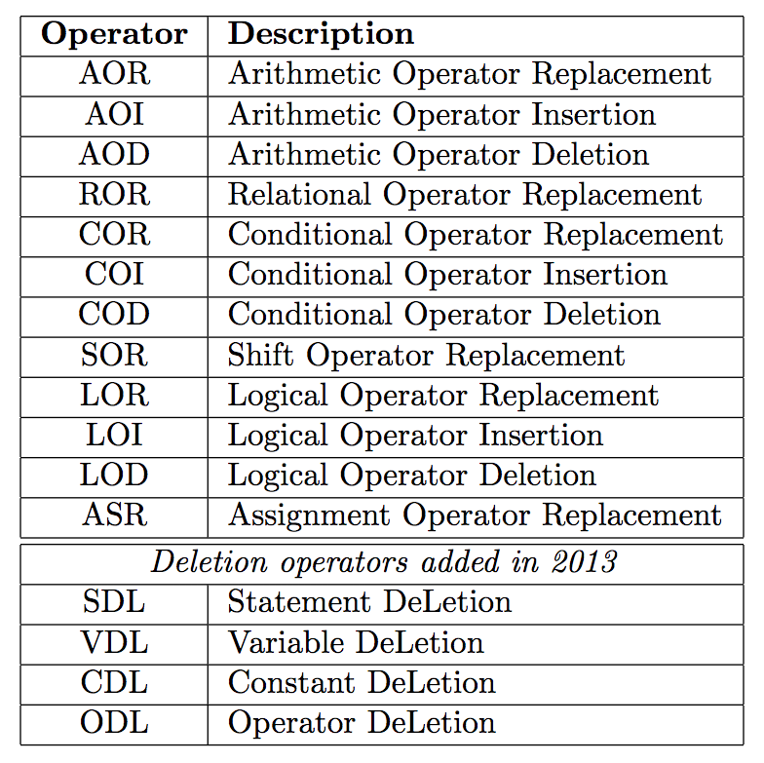
Mutation Operators for Java
[http://cs.gmu.edu/~offutt/mujava/mutopsMethod.pdf]

Slide 26
Example: MuJava Operator (AOR)
Example:
1
2
3
4

Slide 27
Example: MuJava Operator (ROR)
Example:
1
2
3
4
5

Slide 28
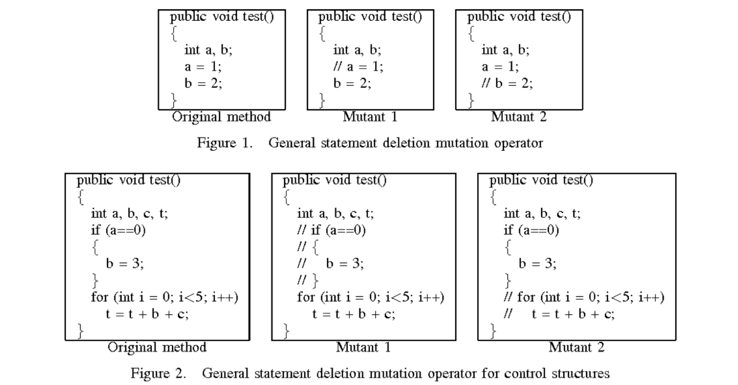
Example: MuJava Operator (SDL)
SDL – Statement Deletion
SDL deletes each executable statement by commenting them out. It does not delete declarations.
General statement deletion

Slide 29
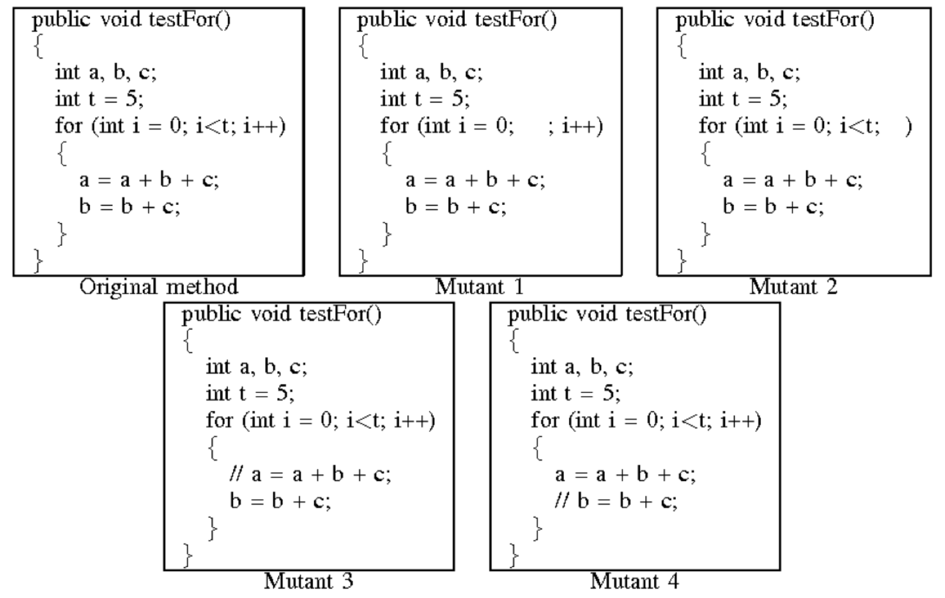
Example: MuJava Operator (SDL)
SDL for for statements

Slide 30
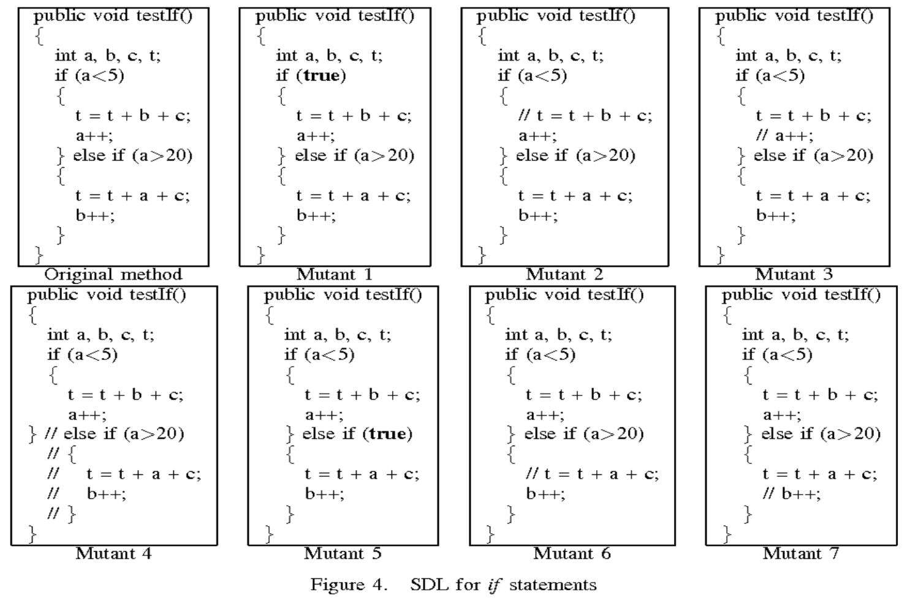
Example: MuJava Operator (SDL)
SDL for if statements

Slide 31
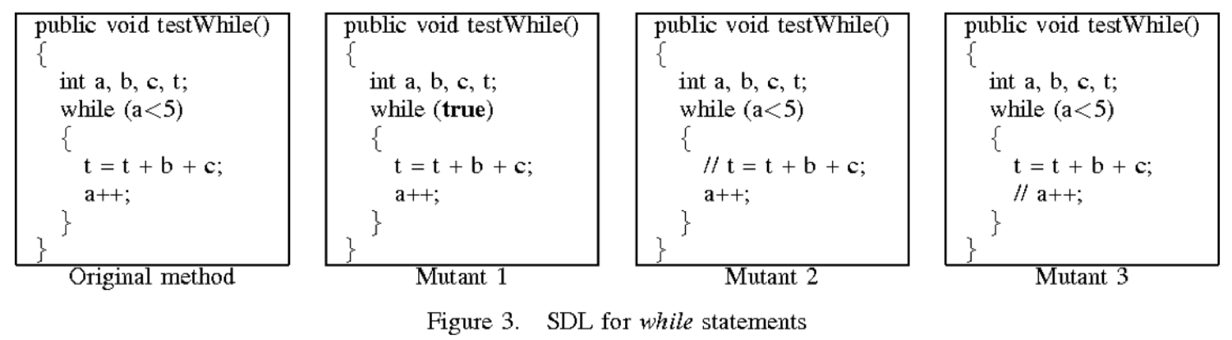
Example: MuJava Operator (SDL)
SDL for while statements

Slide 32
Summary
Mutation is widely considered the strongest test criterion
First-order mutation due to the two assumptions
Competent programmers
Coupling effect
Mutation creates the most test requirements
# test requirements = # mutants
Most expensive
To improve the test process, use selective mutation operators
Mutation testing is very difficult to apply by hand
Mutation subsumes other criteria by including specific mutation operators
Mutation can be applied to various software artifacts, languages, and frameworks with different implementation and specific definition of mutation operators

